Slide 1
BI AND ANALYTICS FOR CHOCOLATE INDUSTRY
GROUP 11
FAISAL HAMID SHAIK
SATYANARAYANA MEKARTHI

Slide 2
LINK TO DATASET
https://www.kaggle.com/datasets/prajwal6362venom/choclate-sales-project/
No modifications made to the dataset.

Slide 3
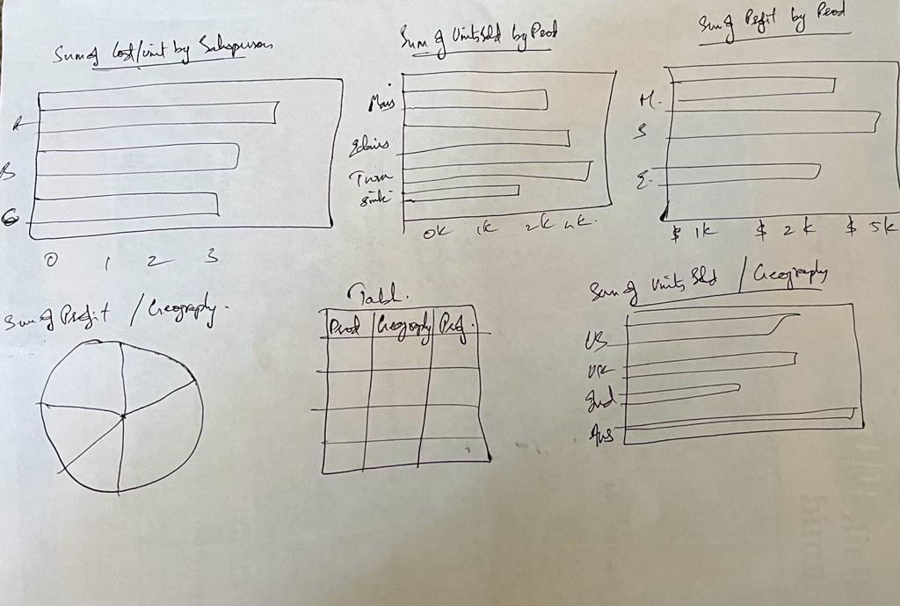
SKETCH

Slide 4
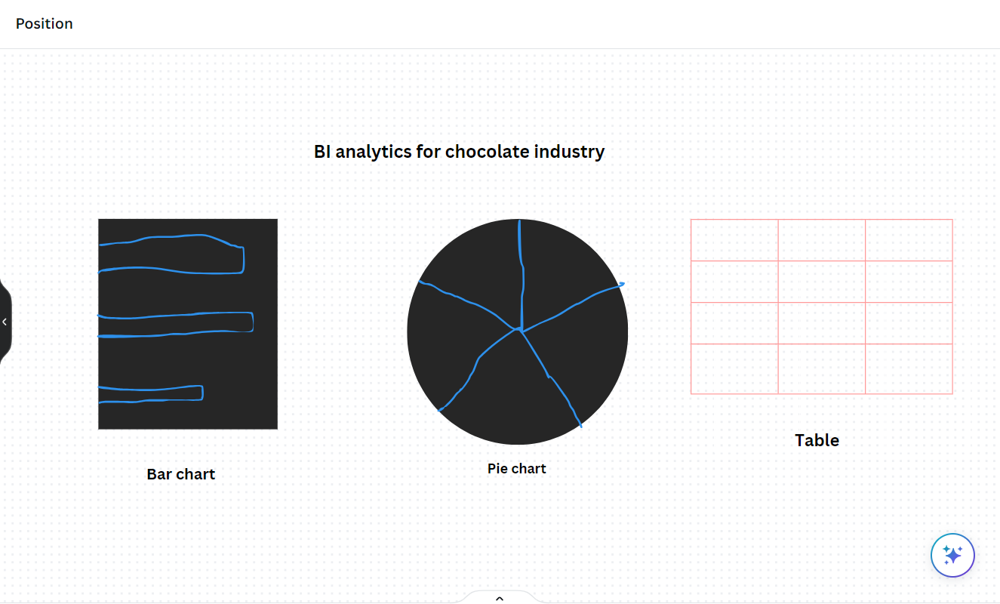
STORYBOARD

Slide 5
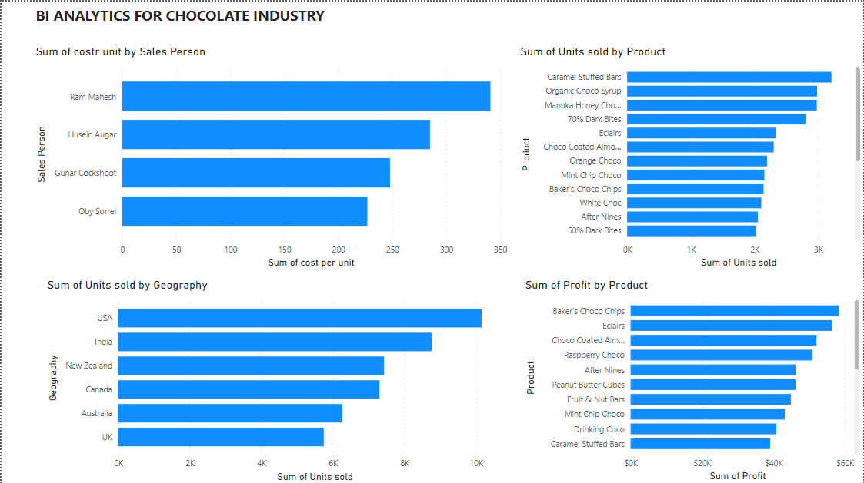
DASHBOARDS

Slide 6
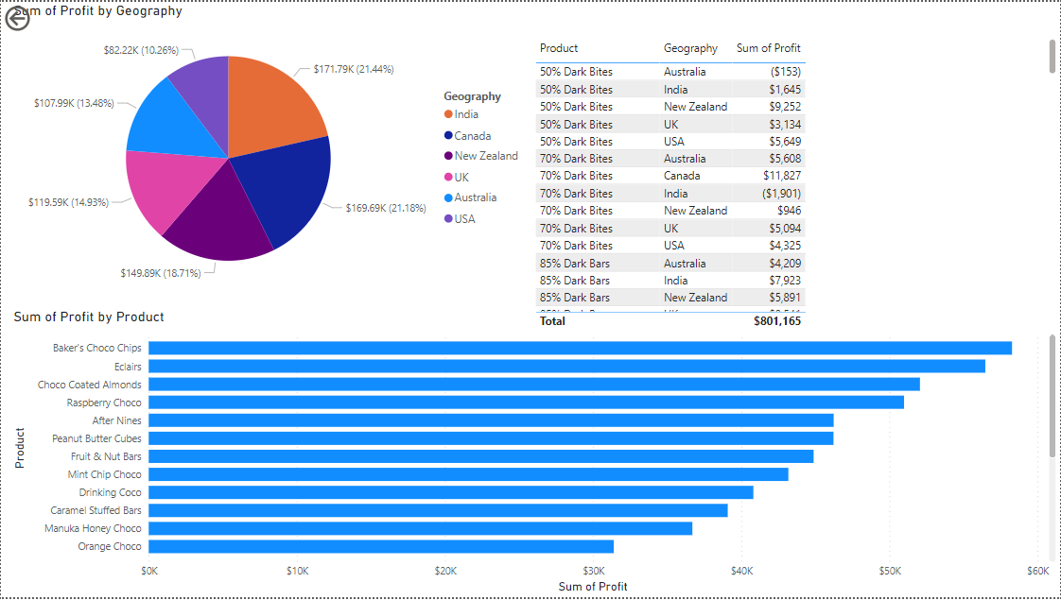
DASHBOARDS

Slide 7
FILTERS
Before filter

Slide 8
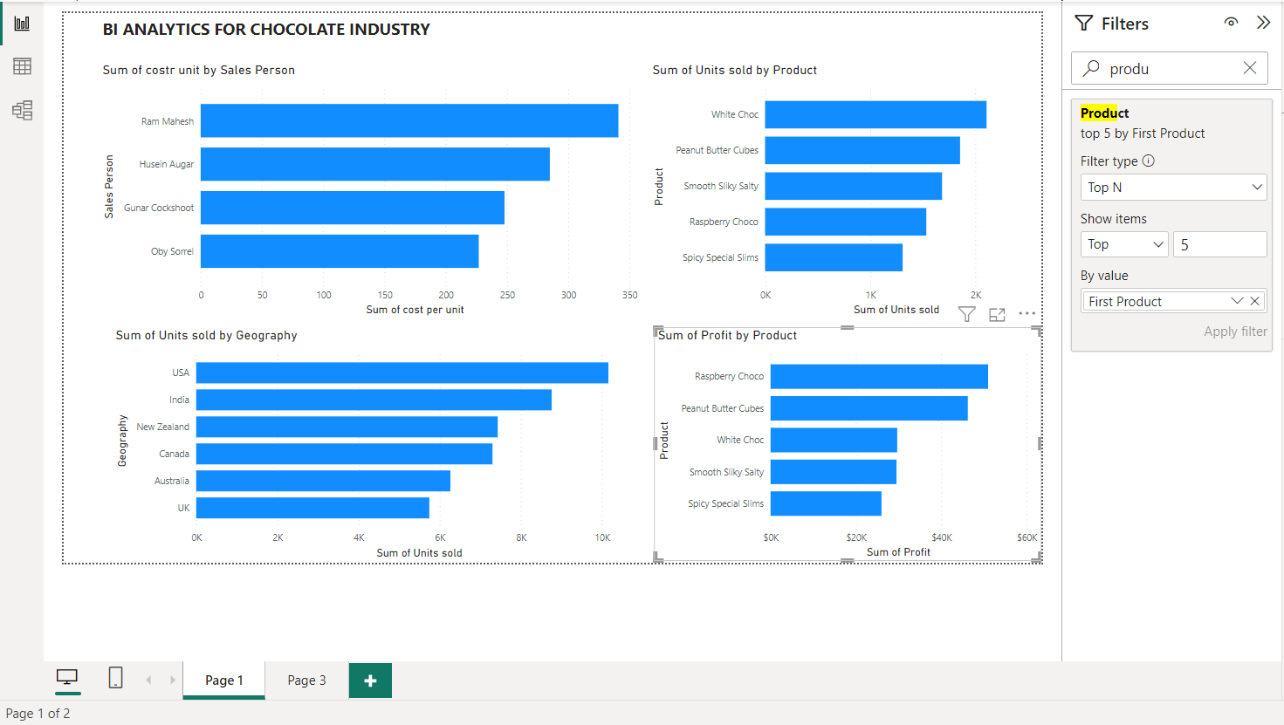
FILTERS
After filter

Slide 9
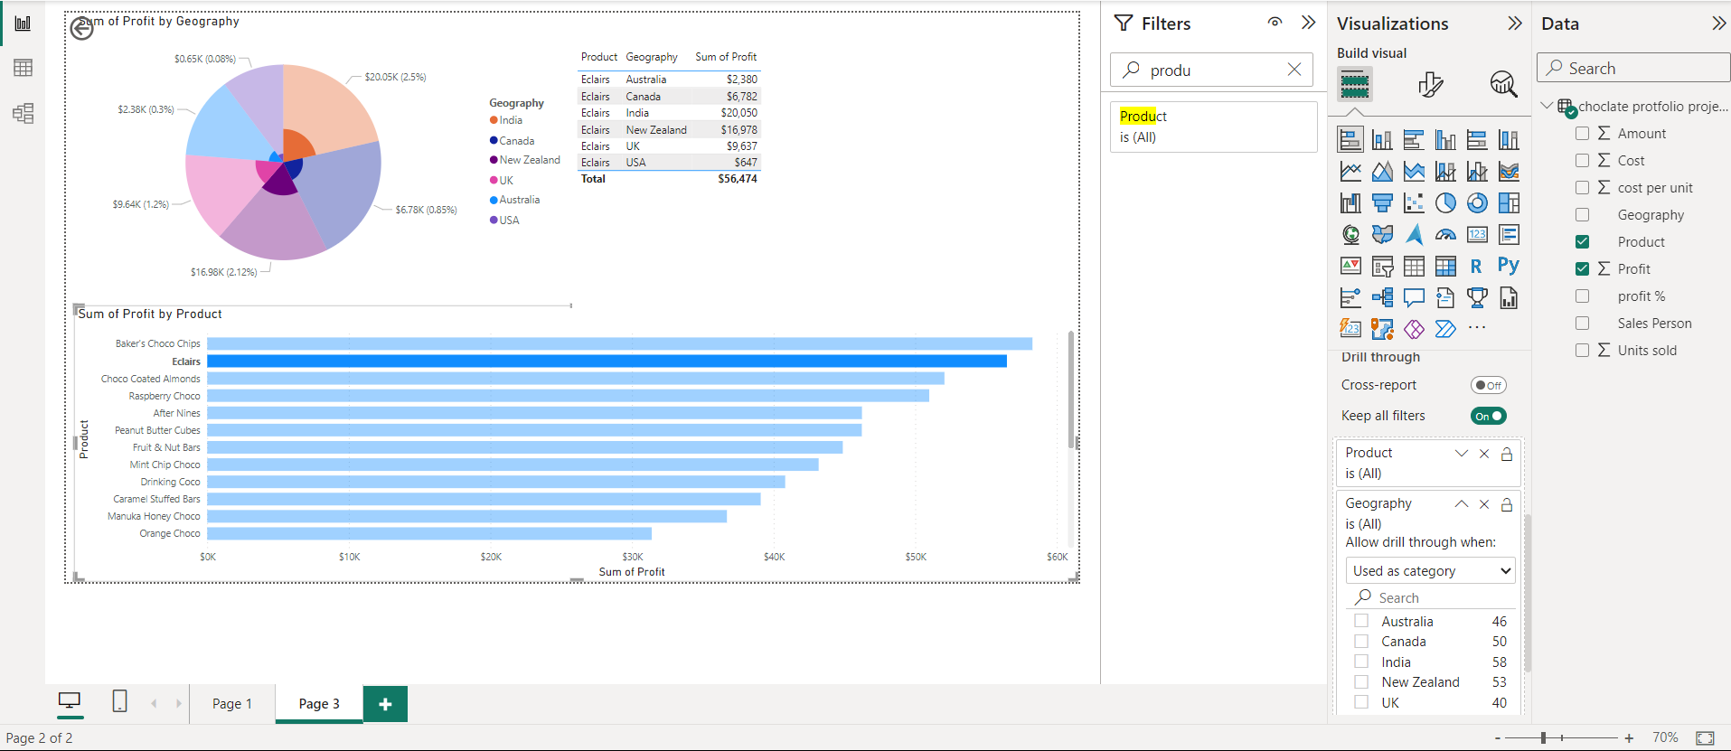
DRILL THROUGH

Slide 10
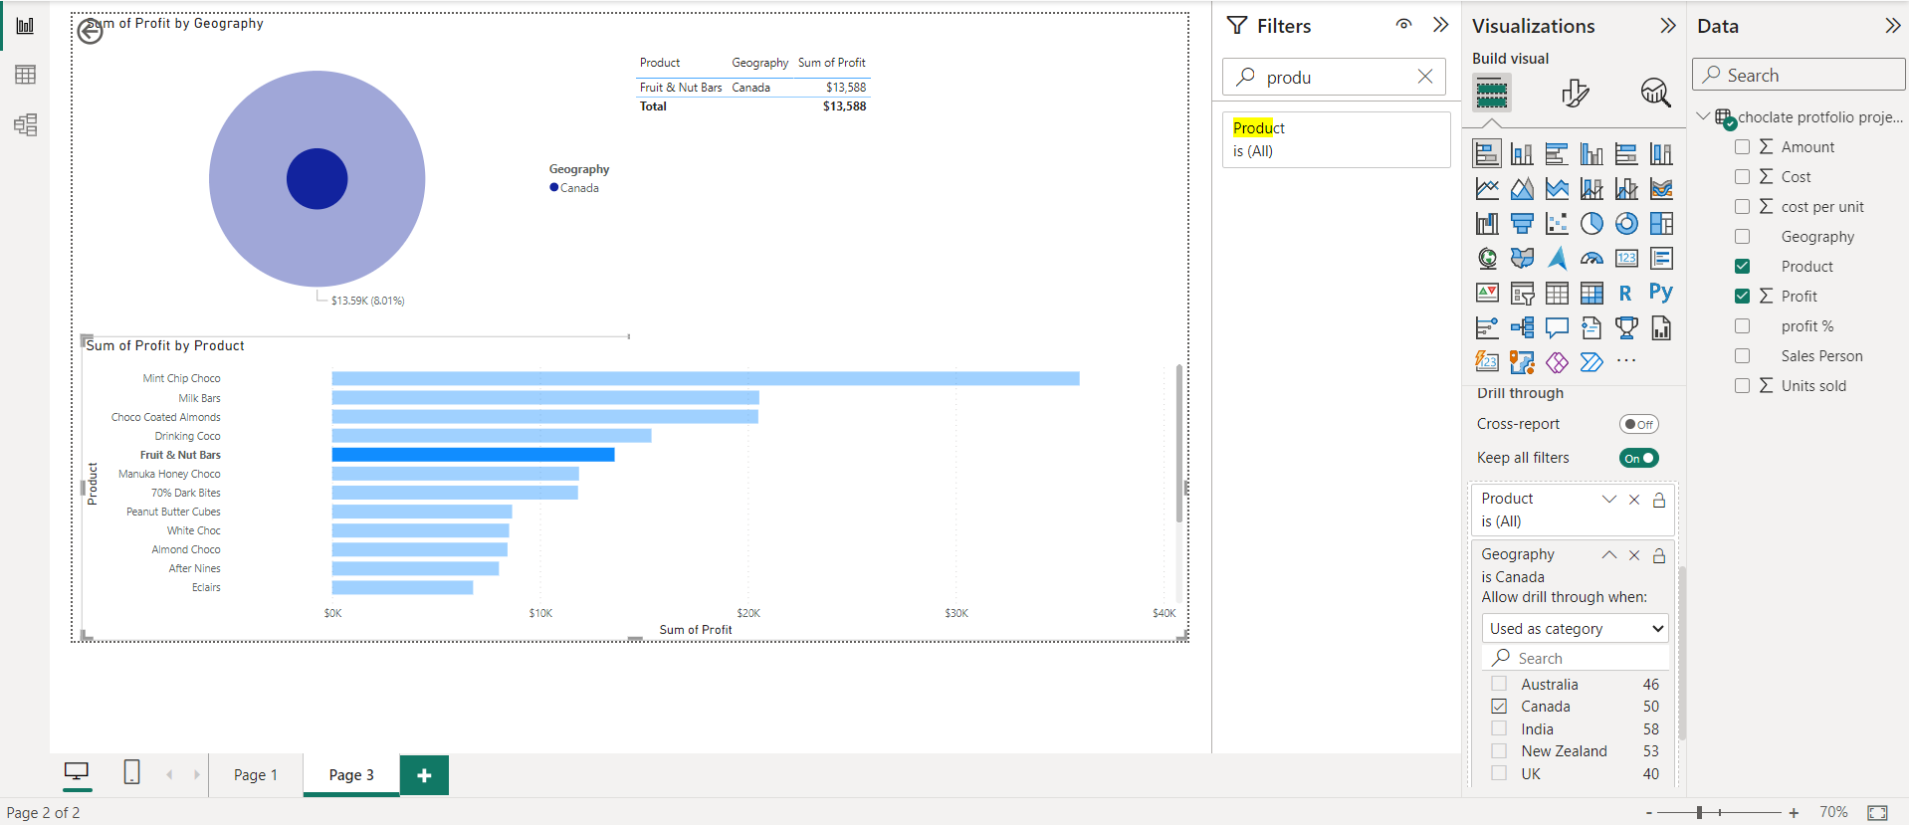
DRILL THROUGH

Slide 11
STORY TELLING
We analyzed a dataset on the chocolate industry and created dashboards to easily understand the information. The data included details like salesperson, geography, product, sales, units sold, cost, profit, and profit percentage. From this, we found that the USA had the highest chocolate sales, followed by India, New Zealand, Canada, Australia, and the UK.
WE also looked at which chocolate products were the most popular. The top five products in terms of units sold were White Chocolate, Peanut Butter Cubes, Smooth Silky Salty, Raspberry Choco, and Spicy Special Slims. These products were the favorites among consumers.
Additionally, we examined the profits generated by each product. The top five products making the most profit were Raspberry Choco, Peanut Butter Cubes, White Chocolate, Smooth Silky Salty, and Spicy Special Slims. This information helps businesses understand which products are most successful and can guide decisions to boost revenue.
So, the analysis of the chocolate industry data through dashboards revealed insights about sales in different regions, popular products based on units sold, and the most profitable products. This information is valuable for making smart business decisions and meeting consumer preferences.
In this project for the chocolate industry data we made a pie chart to display how much profit comes from different places i.e., geographies. Then, we created a table that shows details like which product makes how much profit in each place. After that, we made a bar graph to show the total profit each product brings. The cool part is the "drill-through" feature. If we pick a specific place on the pie chart, you can see all the details about that place. And if you choose a product from the bar graph, you get a detailed table showing everything about that product. Also, the pie chart updates to show where that product is popular. This way, the visuals help explore the chocolate industry data in a simple way.

Slide 12
The actions we would recommend based on the data are :
Focus on the USA: Since lots of people in the USA really like our chocolates, let's do extra work to sell more there. We can make special deals and ads that match what people in the USA love.
Sell the Best Chocolates: Let's pay attention to selling our top chocolates like White Chocolate, Peanut Butter Cubes, Smooth Silky Salty, Raspberry Choco, and Spicy Special Slims. We should spend more time and money on ads for these chocolates and maybe even think about making more types that people really enjoy.
Change Prices Smartly: They can change the prices of the chocolates based on how much money they make. If some chocolates make a lot of money, they can keep the prices the same or maybe even raise them a bit. This way, they can make sure they're making a good profit and still offer prices that people like.
Look Deeper into Sales: We have a cool feature that lets us look deeper into different places or chocolates. Let's use this to understand what people in different areas really like. We can also figure out which chocolates are popular in different places and make sure we have enough of those chocolates available.

Slide 13
THANK YOU

